Slide 1
World War II & Japan

Slide 2
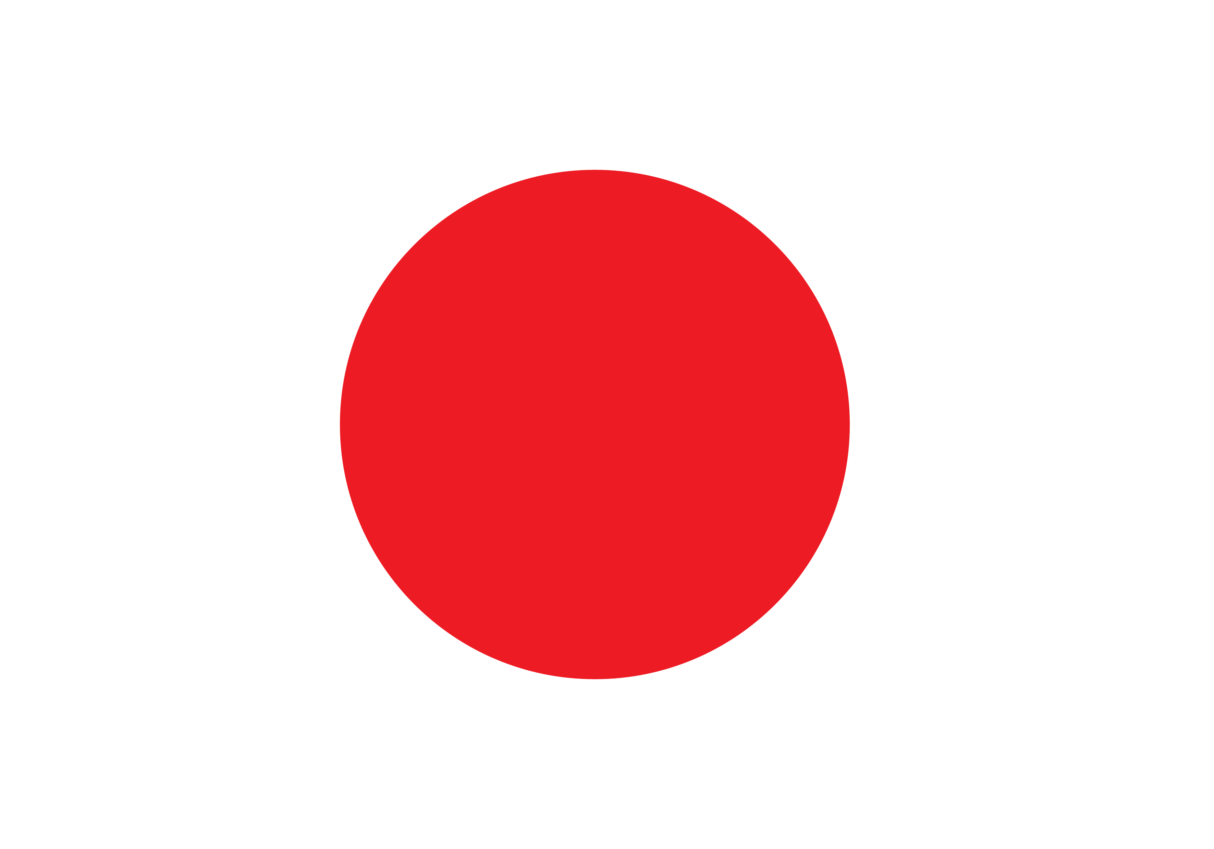
Later Japan
In World War II who did the Japanese side with? The Axis Powers:
Nazi Germany Italy Japan
Japan bombed Pearl Harbor, Hawaii – Dec. 7, 1941
2,500 Americans killed, 18 ships, 300 planes destroyed

Slide 3
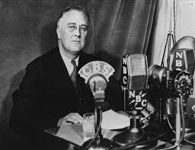
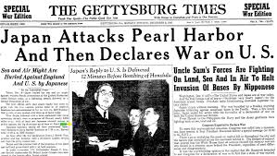
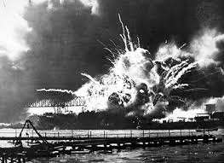
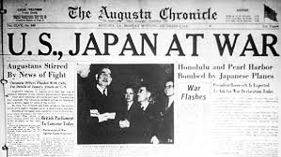
Pearl Harbor, Dec. 7, 1941 - America is brought in WW2

Slide 4
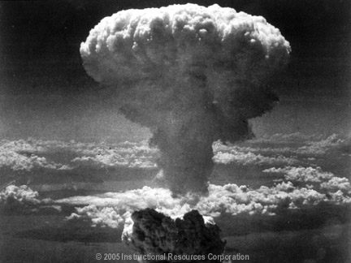
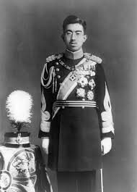
The Manhattan Project-the Atomic Bombs
American plans for bomb begins in 1942
1st nuclear weapons created
Prompted by scientist Albert Einstein

Slide 5
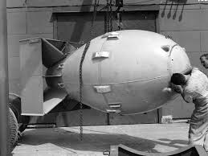
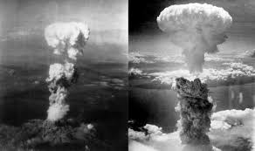
The Bombs – August 1945
Hiroshima bomb – “Little Boy”
Dropped at 8:15 am. – Aug. 6
90,000-150,000 deaths
USS Indianapolis carried parts to Asia
Nagasaki bomb– “Fat Man”
Dropped at 11:02 am – Aug. 9
40,000-80,000 deaths

Slide 6
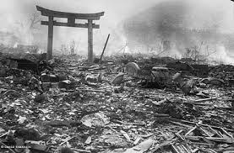
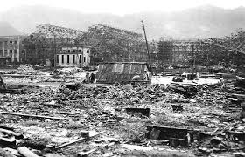
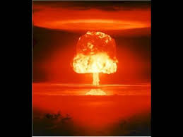
Atomic Bombs Dropped
August 6 & 9, 1945
Hiroshima & Nagasaki
185,000 immediate deaths
Japan surrenders Aug. 15, 1945

Slide 7
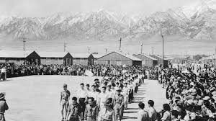
Japanese Internment Camps in World War II
Japanese-American citizens were “re-located” to camps throughout the US, 1942-1946
Executive Order 9066, enacted by President FDR, Feb. 1942
All people of Japanese ancestry must “relocate” to a camp (government wanted to make sure none were spying for the enemy)
Racist policies that violated Japanese-Americans human rights
Camps were in remote, desolate areas of the country
Many Japanese-American families lost homes, businesses, and jobs during the war

Slide 9
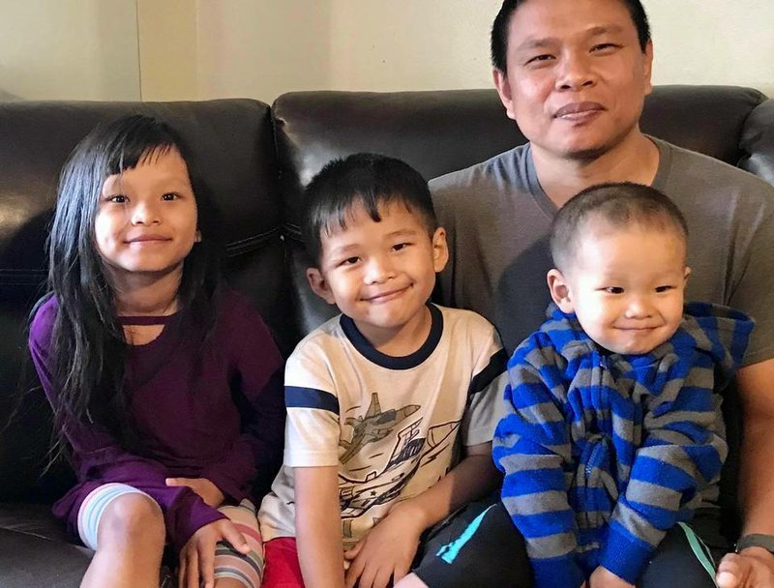
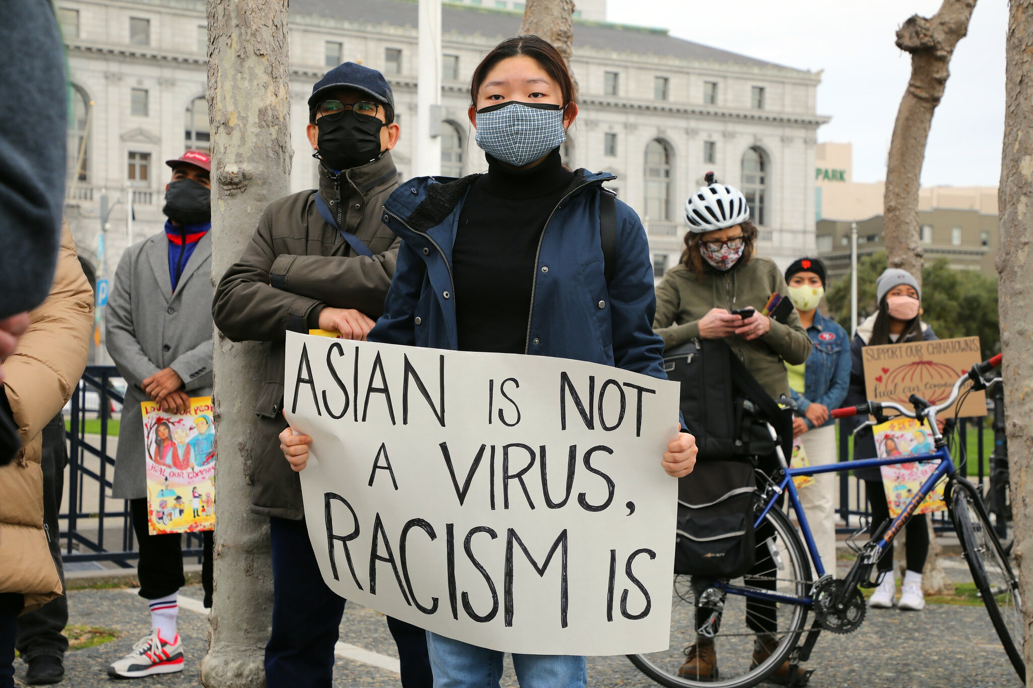
Racism Against Asian-Americans in the US RIGHT NOW…..
March 2, 2021, New York Times
“Lesson of the Day: A Rise in Attacks on Asian Americans”
March 2, 2021
“Asian Americans Suffer Racist Attacks During COVID-19 Pandemic”
February 28, 2021
“Attacks on Asian Americans in NY, Stoke Fear, Anxiety”
February 26, 2021
“Asian American Man Attacked in LA’s Koreatown”

