Slide 1
West Africa Today

Slide 2
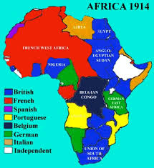
The Colonial Era
Late 1800s- European countries scramble for control of Africa at the Berlin Conference
Want African natural resources
Carve up the continent into colonies
Ethnic groups are split, this disrupts African society
Europeans move to Africa

Slide 3
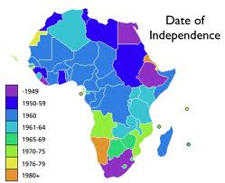
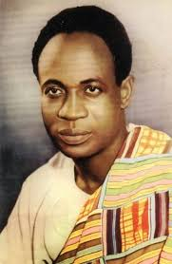
Independence
After WWII, African countries begin to fight for their independence
Independence gained in 1950s,1960s, and early 1970s
Kwame Nkrumah, Ghana

Slide 4
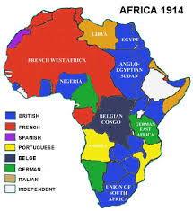
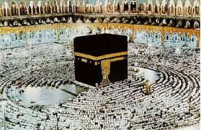
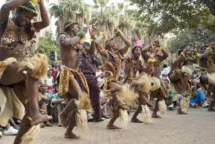
What are the 3 main influences on West African Society?
Traditional African cultures
Islam
European Culture

Slide 5
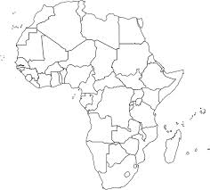
African Religion
Islam
Animism: belief that natural objects have spirits (trees, rivers, mountains)
Ancestors are very significant
Traders bring Islam to West Africa after about 700 AD, popular in the north, to the south Christianity

Slide 6
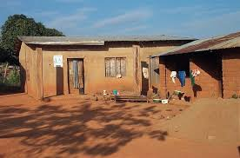
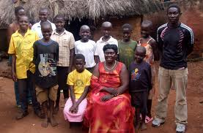
Life in West Africa
Extended families live in the same village, sometimes the same home
Homes are simpler than American homes
West Africa has over 250 ethnic groups, hundreds of languages are spoken

Slide 7
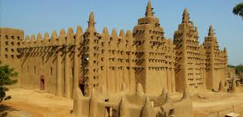
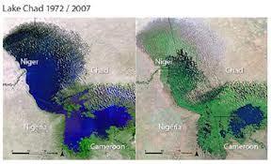
Challenges Facing West Africa
Terrorism – Boko Haram
Famine/Drought
Desertification
Poverty

Slide 8
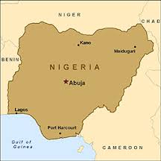
Nigeria
Largest population in Africa
More than 130 million people
Government = Democracy
Nigeria has lots of oil (they are in OPEC)
Problems with terrorism

Slide 9
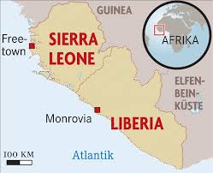
Liberia
Americans founded Liberia in the 1820’s
Sent freed slaves to Liberia
Location of latest Ebola epidemic

