Slide 1
What Was the Silk Road?
Emerges during Han Dynasty
Long-distance trade route network connecting China (East) to Europe (West)
Luxury goods were traded that were light – silk, jade, spices, porcelain, wool, gold
Most traders only travel PART of the road

Slide 2
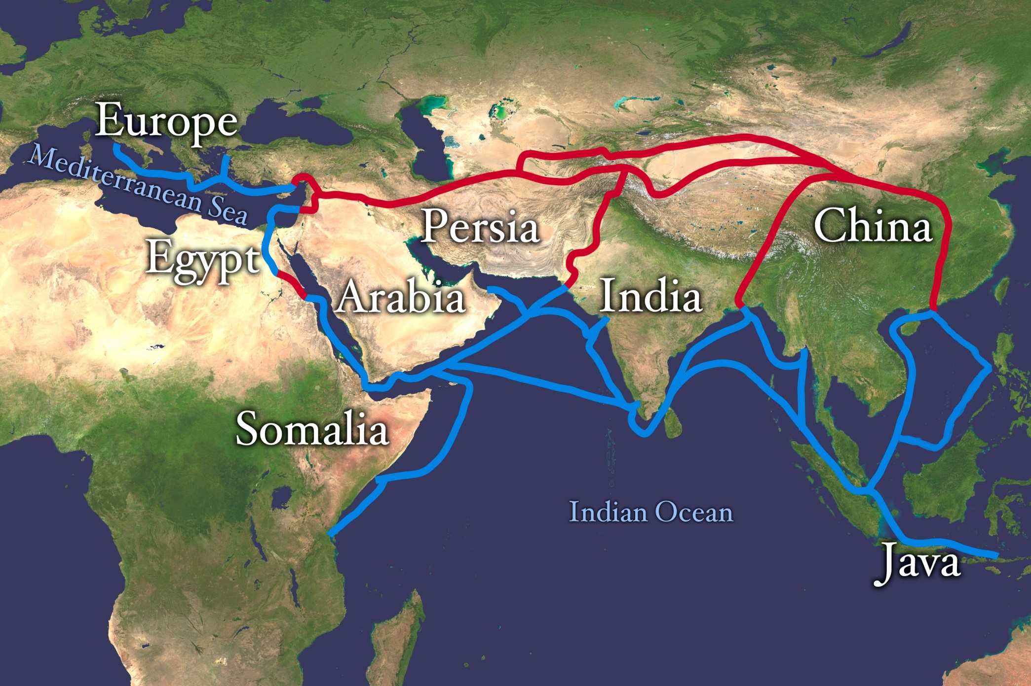
THE SILK ROAD TRADE ROUTE

Slide 3
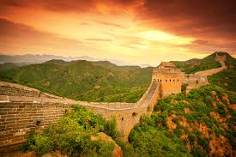
Silk Road Trading
Safety was a concern – people traveled in groups for safety = caravans
China guaranteed travelers safety in their territory (and extended the wall for added protection)
Camels were used for desert travel
Trade cities develop along the route so traders can rest, eat, trade, re-supply

Slide 4
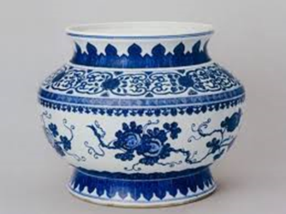
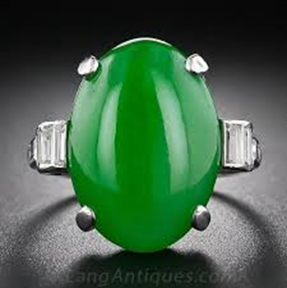
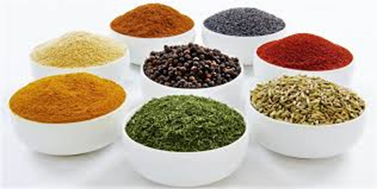
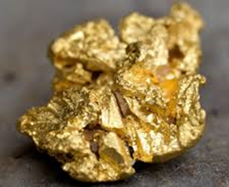
Who was trading what?
China – silk and jade (the Romans LOVED silk)
Silk production was a secret—Only the Chinese new how to make it!
Africa – Salt, ivory, gold
Europe – olives, glass, horses
Middle East & Egypt – carpets, perfume
India – spices, cotton, ivory, pearls

Slide 5
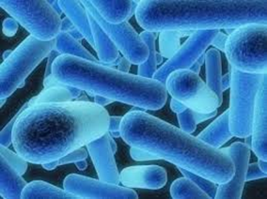
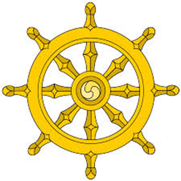
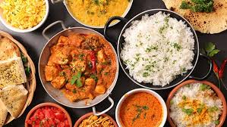
What else traveled the road?
Disease spread via the Silk Road – measles, smallpox, and plague
Religion spread to new areas- Buddhism from India & Islam from Arabia/North Africa
Food
Ideas
CONNECTION OF CULTURES! =
Cultural Diffusion

Slide 6
Who Was Marco Polo?
Italian Merchant
1271-1295, traveled in China (Yuan Dynasty)
Served in the Chinese Emperor’s court
Wrote about his travels
Informed Europeans about the East in his popular book, The Travels of Marco Polo

