Slide 1
The New Kingdom

Slide 2
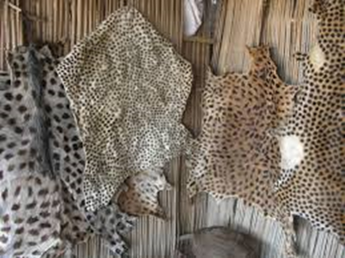
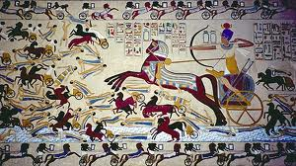
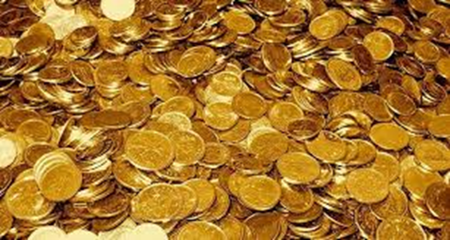
The New Kingdom
New Kingdom- when Egypt reached its height of power and glory, 1550-1050 BC
Military conquests made Egypt rich
Conquered kingdoms sent tribute
Tribute-yearly payments (gold, precious stones, & leopard skins to pharaohs)

Slide 3
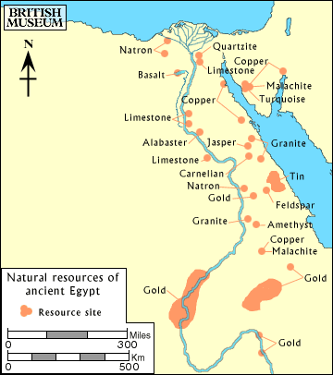
Egyptian Trade
Egyptians traded with surrounding areas…
Slaves
Gold
Copper
Ivory
Wood

Slide 4
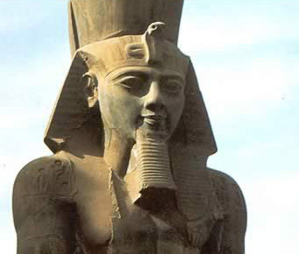
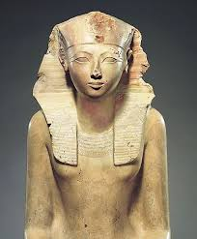
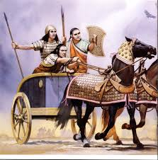
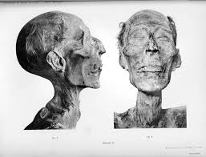
Pharaohs of New Kingdom
King Tut – “The Boy King,” died an early death
Queen Hatshepsut –(female pharaoh from 1503-1482 BC) was renowned for trade, erased from history
Ramses II (or Ramses the Great) –
great military leader and builder,
over 100 kids?

Slide 5
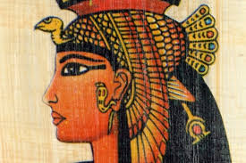
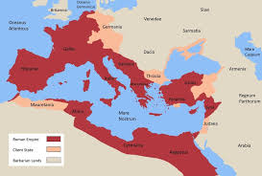
End of the Pharaohs
Last pharaoh = Cleopatra VII
Dies 30 BC (suicide or by Romans?)
Egypt is then controlled by the Roman ruler, Octavian
Egypt becomes part of
Roman Empire

Slide 6
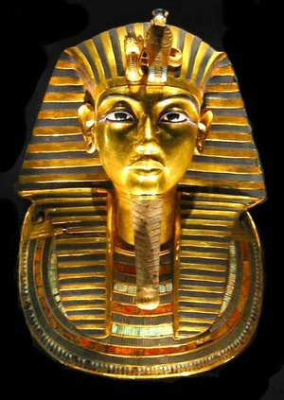
Who was King Tut?
Most well-known pharaoh
Born-1341 BC
Died-1323 BC
Real name was “Tutankhamun”
Married to his half-sister at age 9
Dies at age 19 – known as the “Boy King”
Mystery as to how he died…

