Slide 1
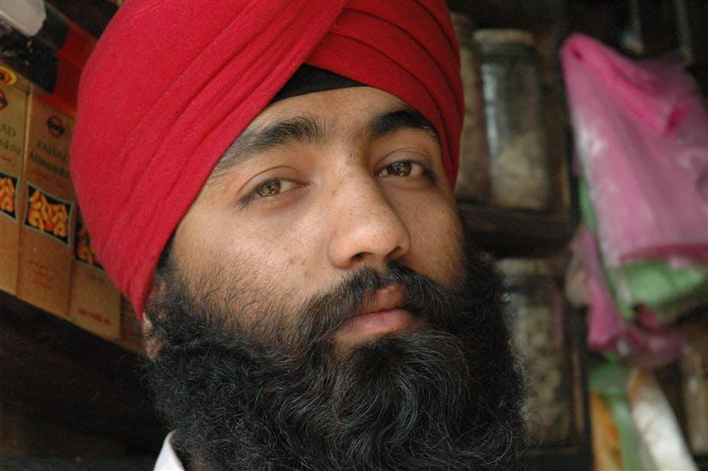
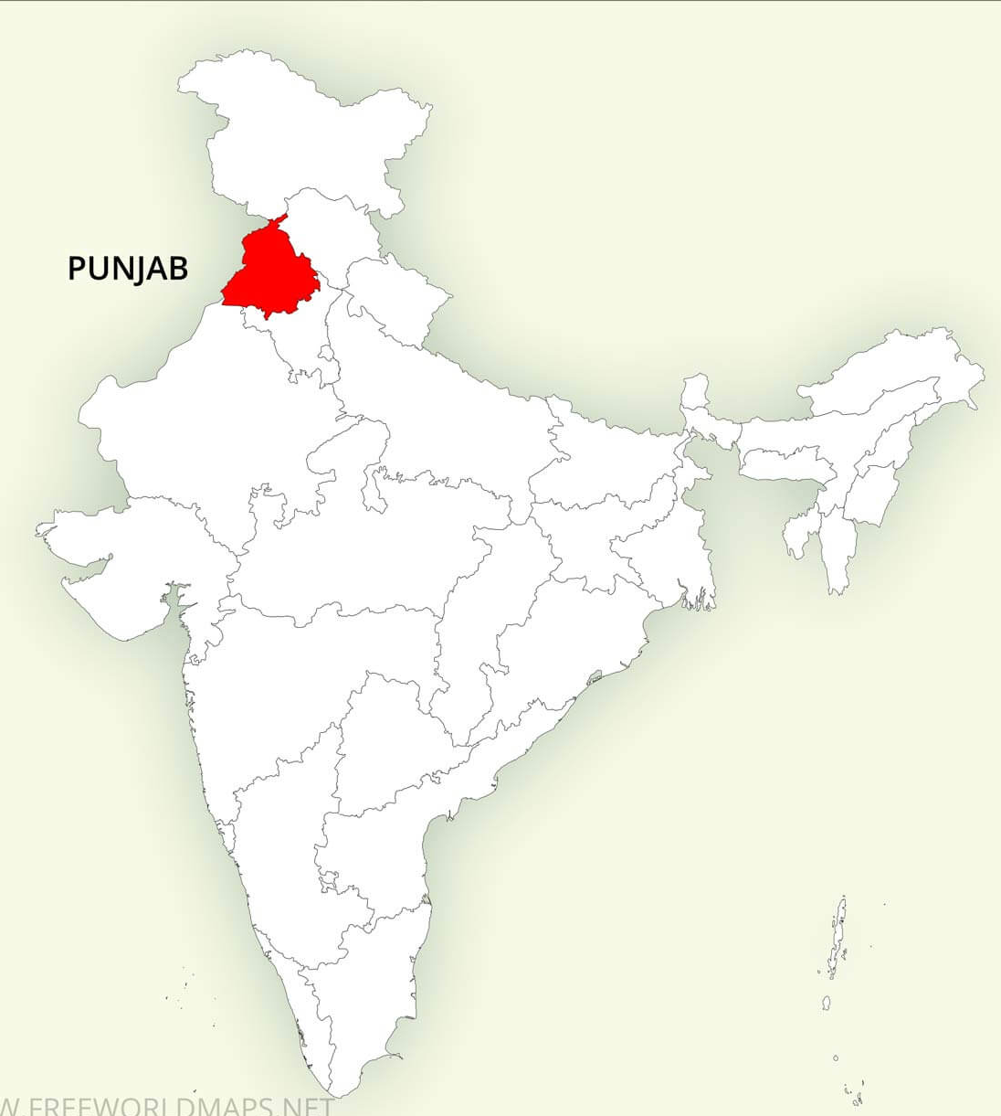
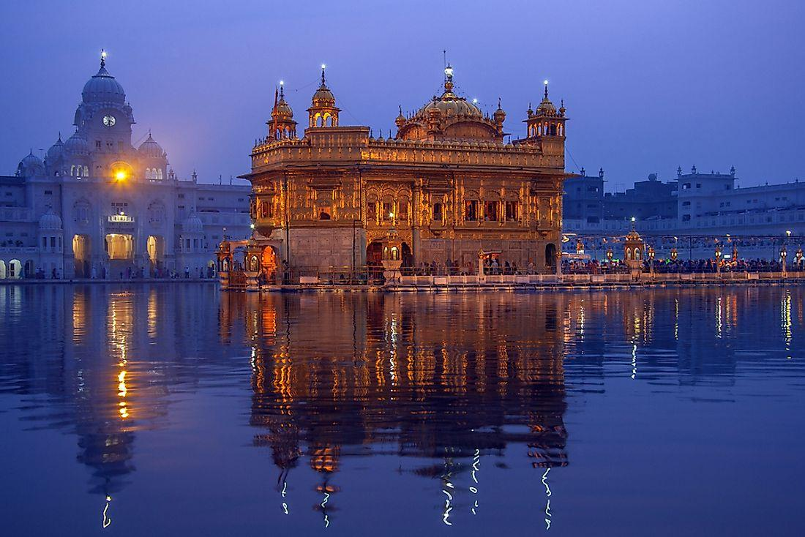
Sikhism
(Sick-ism or Seek-ism))

Slide 2
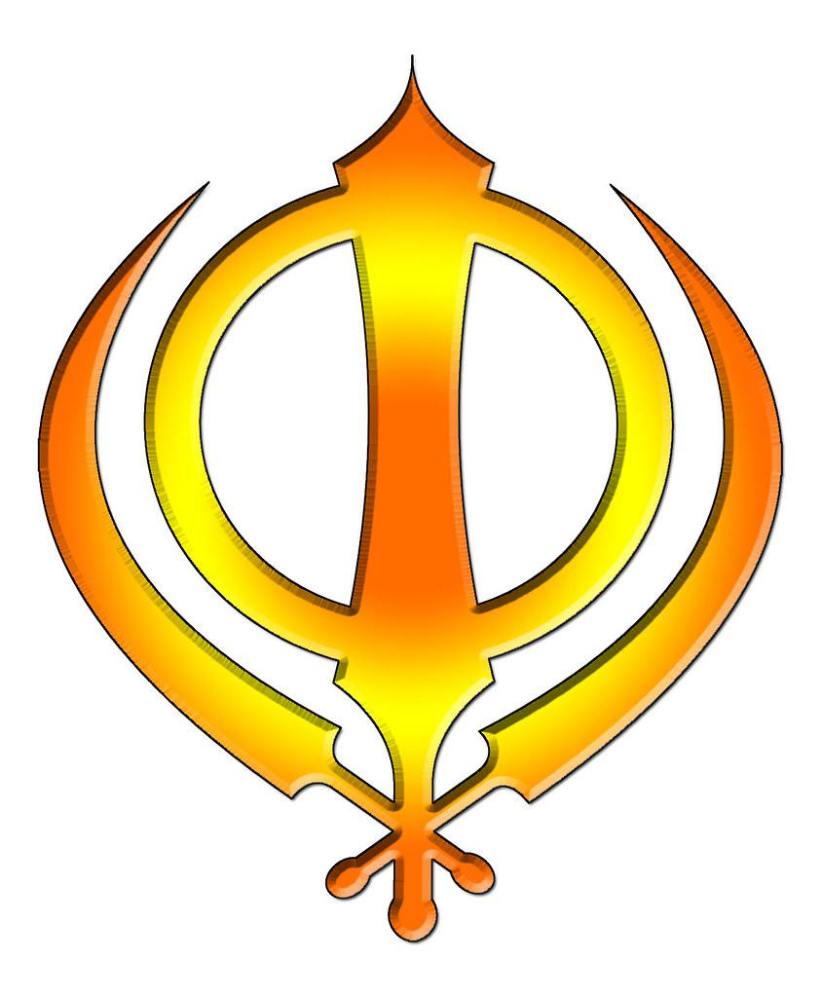
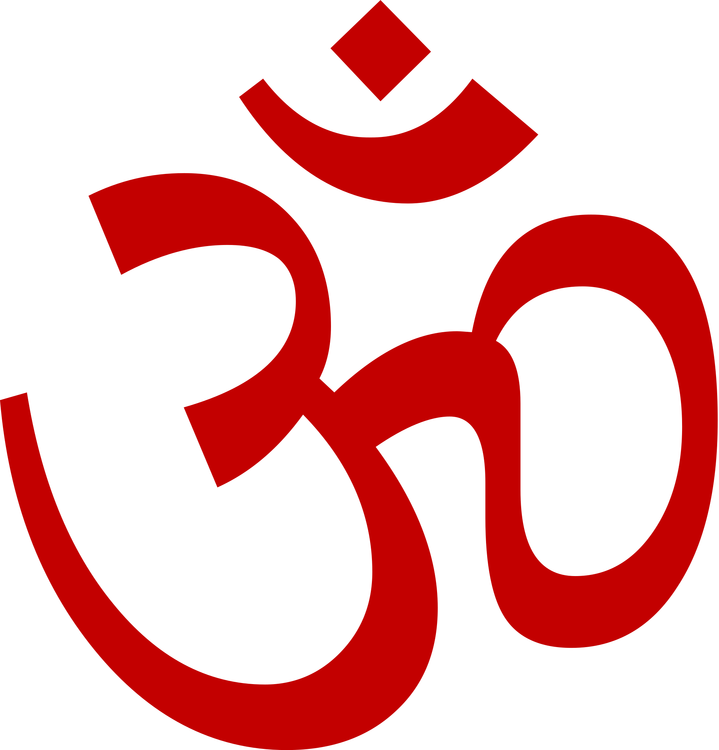
World Religions
Hinduism
15%
Judiasm
.2 %
Buddhism
7.5%
Chrisitianty
32%
Islam
24%
Sikhism
.4%
2000 BCE?
1800 BCE
~ 550 BCE
30 CE
610 CE
1500 CE

Slide 3
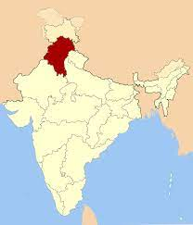
Some Sikhism Basics….
30 million followers worldwide (5th Largest)
Very young faith - 1500 AD/CE
Founded in northern India/Pakistan
Language of the faith - Punjabi
“Sikh” (sick) = “Student/Learner”
Monotheistic Faith
Respect all faiths- Jesus and Muhammad are seen as holy men, “saints”

Slide 4
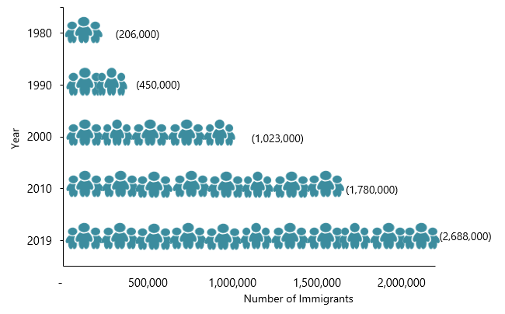
Immigration to the United States...
About 500,000-700,000 Sikhs in the U.S. (30 million worldwide)
Largest populations on the coasts but other large communities include Chicago, Detroit, Houston, Dallas, and Indianapolis
From 1980 to 2019, the Indian immigrant population in the US increased 13-fold (see Figure 1).
Sources: Data from U.S. Census Bureau 2010 and 2019 American Community Surveys (ACS), and Campbell J. Gibson and Kay Jung, "Historical Census Statistics on the Foreign-born Population of the United States: 1850-2000" (Working Paper no. 81, U.S. Census Bureau, Washington, DC, February 2006), available online.

Slide 5
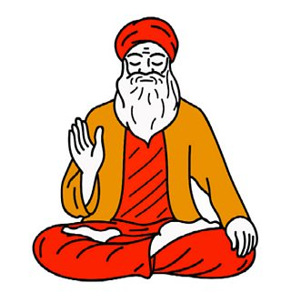
Religious Leaders
Guru = “Teacher”
Guru Nanak - 1st Guru, founder of religion in 15th century
Raised a Hindu, rejected Hindu & Muslim teachings
Gurus are NOT manifestations of God, but are without sin
Guru Nanak rejects the caste system
9 gurus follow Guru Nanak for a total of 10 gurus
Each guru is inhabited by a single spirit

Slide 6
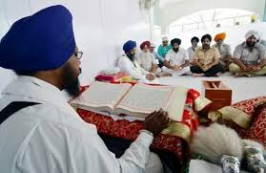
Holy Book
Guru Granth Sahib - Holy Book of scripture, “First Book”
Like a Bible, Koran, or Torah
Summarization of the teaching of the 10 gurus, hymns
Focuses on how to live a life in which you can find god within yourself
Words spoken by the gurus, believed to contain the words of Waheguru - God

Slide 7
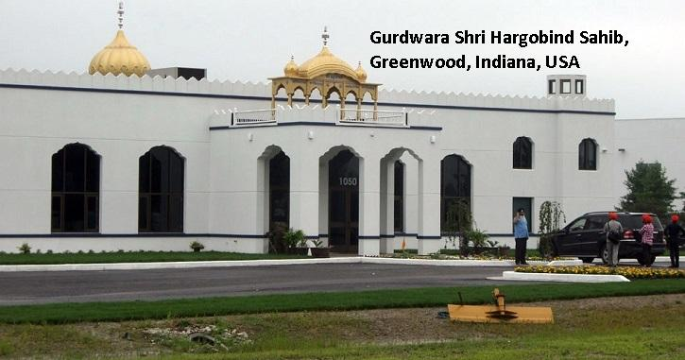
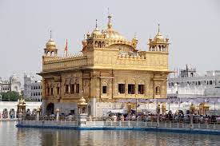
House of Worship
House of Worship - Gurdwara (Goord-Vhar-Ah)
“Guru’s Door” - a place of learning
People of all faiths are are welcome in the gurdwara
Each Gurdwara has a copy of the Guru Granth Sahib
Part of each gurdwara is a langar - a communal dining hall/meal where free food is cooked and served to the congregation (only vegetarian usually!)
Weekly attendance not mandatory, no specific sabbath day (holy day of the week)

Slide 8
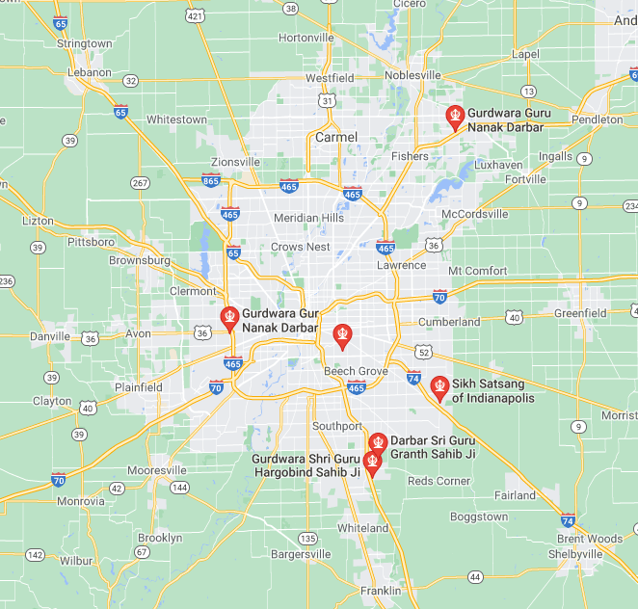
Gurdwaras
(Sikh temples)
in the
Indianapolis
area

Slide 9
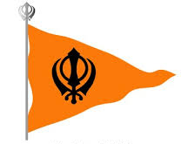
Core Beliefs
Belief in one God, this God does not have a form/gender
God is beyond all human comprehension but can be found through prayer, honest work, and giving to others
Equality of all humans before God, all have equal access
Serving God by serving others - strong duty to family and community
Reincarnation - a cycle of life, death, & rebirth with the hope of one day breaking out of the cycle to achieve union with God
Overcoming the 5 vices of self-centeredness: lust, greed, anger, pride, attachment to the objects of this work

Slide 10
The 5 K’s of Sikhism (Articles of Faith)
Kesh - Do not cut their hair, men wrap it up in a turban
Kangha - comb to used to groom the hair, sign of hygiene
Kara - steel circular bracelet, showing that Sikhs are bound to the truth
Kirpan - small dagger/sword, signifies defense of the weak
Kachera - cotton underwear

Slide 11
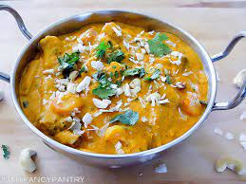
Guidelines for Living
No alcohol, smoking, tattoos/piercings discouraged
Vegetarian if part of community/encouraged
If meat, must be killed as quick and as painlessly as possible, no sacrificial killings
As a way to show rejection of caste system, Sikhs take the last name Kaur (women) and Singh (men) after becoming part of Sikh community
Kaur = Princess, Singh = Lion
By taking the same names, they show their belief in equality

Slide 12
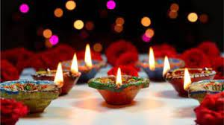
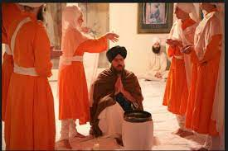
Festivals/ Holidays
Diwali - Festival of Light, New Year,
celebrated by Sikhs as well as Hindus
Taking “Amrit” - when someone chooses to join the Sikh community, will change last name and start wearing the 5 K’s, no specific age

Slide 13
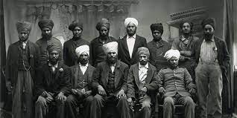
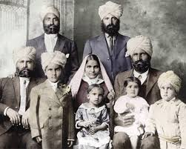
Sikh History
Appears around 1500 AD/CE
In 1600s, Sikhs come into conflict with Muslim rulers
1800-1850 AD/CE, Sikh Ranjit Singh rules in Punjab
1850 AD/CE - Punjab becomes part of the British colony of India
Sikhs were sent as soldiers, by the British to other parts of the world
In 20th century, Sikh immigration expands and increases in US after WW2

Slide 14
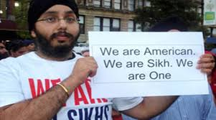
Problems with discrimination…
“US Sikh community traumatized by yet another mass shooting” April 21, 2021
“Gunman Kills 6 at a Sikh Temple Near Milwaukee” August 5, 2012
“15 years after 9/11, Sikhs still victims of anti-Muslim hate crimes” September 15, 2016

Slide 15
Sources:
“What is Sikhism?” by Anita Kumar Gill, Slideshare, April 22, 2010
BBC - https://www.bbc.co.uk/religion/religions/sikhism/beliefs/beliefs.shtml,
Religions: Sikh Beliefs , 9-24-2009
BBC - Bitsize: Sikh Beliefs -https://www.diffen.com/difference/Christianity_vs_Sikhism
Diffen: Christianity vs. Sikhims https://www.diffen.com/difference/Christianity_vs_Sikhism
Pew-Templeton Global Religious Futures Project - http://www.globalreligiousfutures.org/religions/jews
Migration Policy Institute - https://www.migrationpolicy.org/article/indian-immigrants-united-states-2019
Indy Star - https://www.indystar.com/story/news/local/indianapolis/2021/04/16/indianapolis-fedex-mass-shooting-victims-sikh-indiana-community/7258846002/, “4 killed in FedEx shooting were part of Sikh community. What to know about Sikhs,” April 21, 2021

