Slide 1
Religion & Mummification

Slide 2
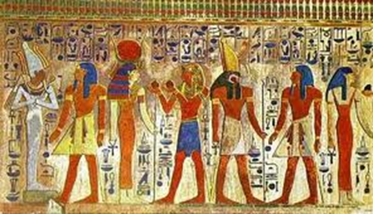
Egyptian Religion
Egyptians were polytheistic
Built temples to honor gods
Certain cities became associated with certain gods
Many Egyptians have shrines in their homes

Slide 3
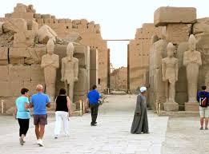
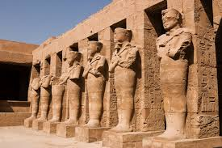
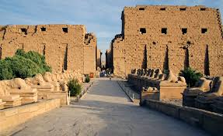
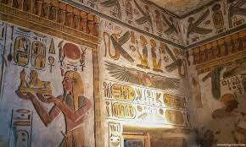
Temples at Karnak
Most famous temple complex – dedicated to god Amun-RA

Slide 4
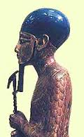
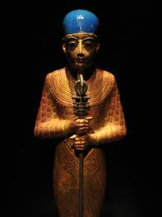
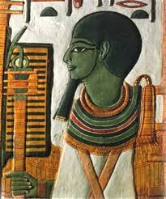
Ptah - Creator of the world

Slide 5
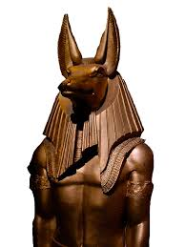
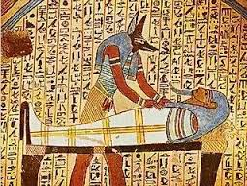
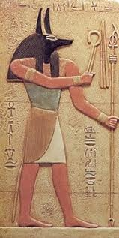
Anubis - God of the dead

Slide 6
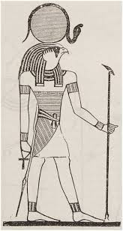
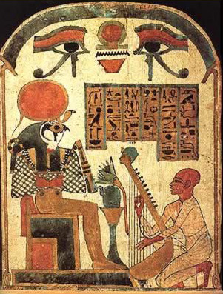
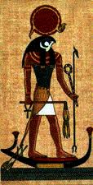
Re - God of the sun

Slide 7
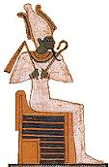
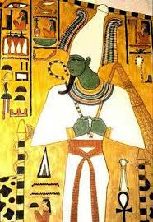
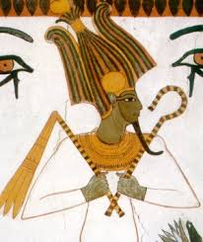
Osiris - God of the underworld

Slide 8
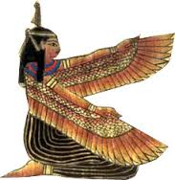
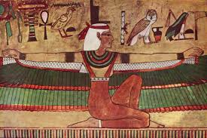
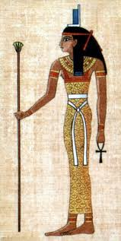
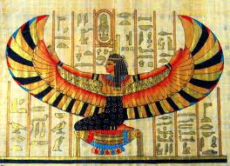
Isis - Goddess of magic

Slide 9
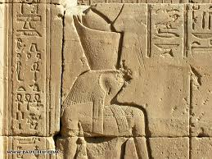
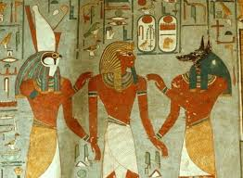
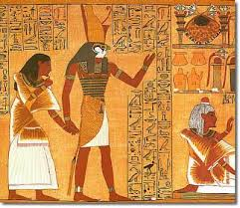
Horus - God of sky and pharaohs

Slide 10
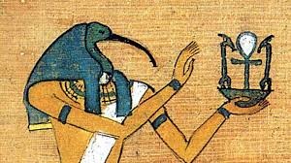
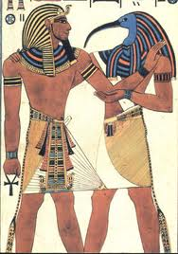
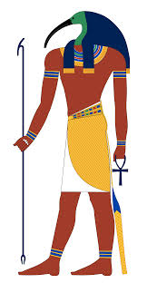
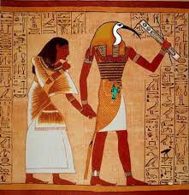
Thoth - God of wisdom

Slide 11
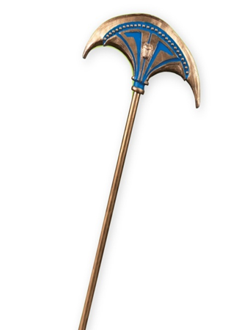
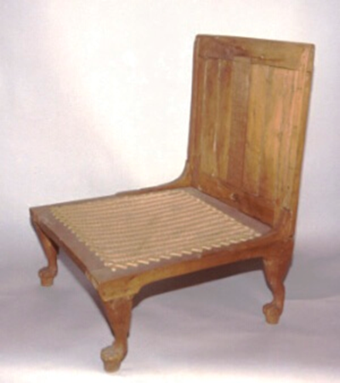
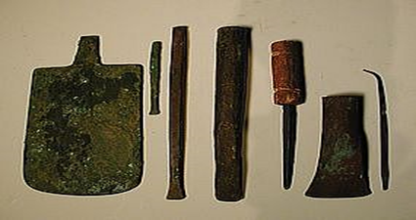
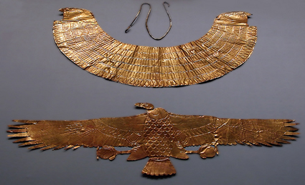
Afterlife
Egyptians believed in an afterlife
Afterlife- life after death
When a person died their ka left their body
Ka- a person’s life force
A person’s ka had the same needs as a regular human…

Slide 12
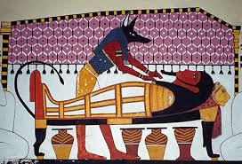
Burial Practices
Egyptians believed that bodies must be preserved
Ka needs to be able to recognize the body to return to it
Mummification – the process used by Egyptians to preserve a dead body

Slide 13
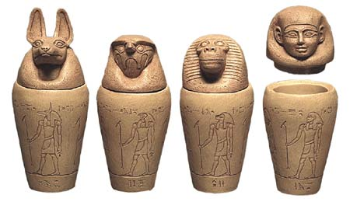
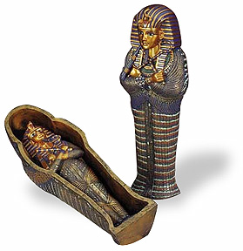
Burial Practices
Only royalty & Egypt’s elite could afford to be mummified
Elite- people of wealth and power
Peasant families buried dead in shallow graves near desert (the hot, dry sand preserved the bodies naturally)

Slide 14
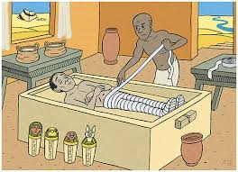
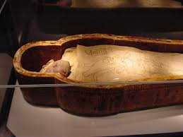
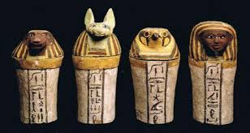
Burial Practices
Canopic
Jars – Organ jars
How to make a mummy…
Remove all organs except the heart
Body is stuffed with natron (dried out)
Treated with oils
Wrapped in bandages (with charms)
Placed in stone coffin (sarcophagus)

Slide 15
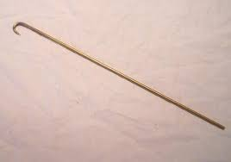
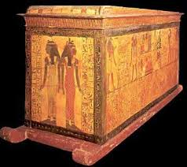
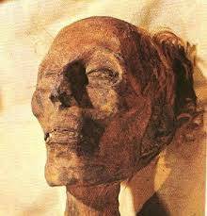
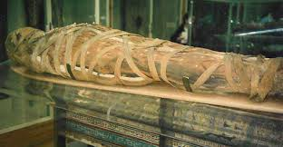
Egyptian Mummies

Slide 16
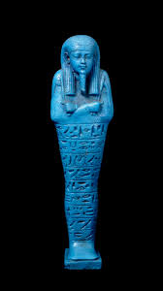
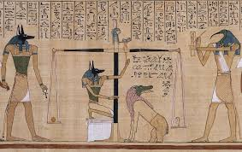
And don’t forget to include…..
The Book of the Dead – a scroll/text included in the burial that
would help guide the dead through the underworld
Written on papyrus (Egyptian paper-like material)
full of spells and advice to guide and protect
shabti dolls – small dolls that would come
to life to serve as your workers/helpers in the
afterlife

