Slide 1
Egyptian History
Timeline
Old Kingdom
2700-2200BC
Middle Kingdom
2050-1750BC
New Kingdom
1550-1050BC

Slide 2
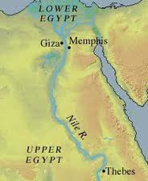
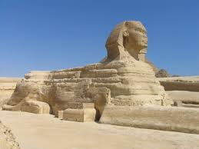
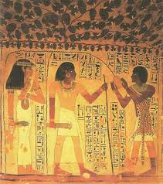
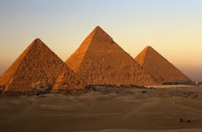
The Old Kingdom: Age of the Pyramids

Slide 3
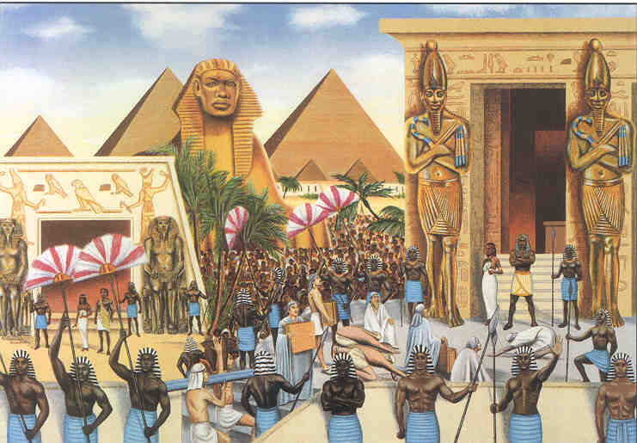
Old Kingdom
Old Kingdom- a time in Egyptian history that lasted around 500 years, 2700BC – 2200BC
(Sargon conquers Sumer during this time)

Slide 4
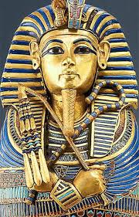
Pharaohs
Believed to be gods
Have absolute power
Blamed for bad trade/war/crops
(like a manager of Egypt for the gods)

Slide 5
Pyramids
Pyramids- huge stone tombs with 4 triangle shaped sides that met in a point on top
Egyptians were excellent
engineers
Engineering- the application of scientific knowledge for practical purposes

Slide 6
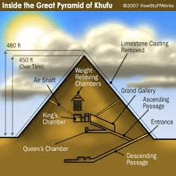
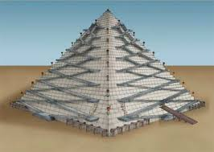
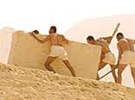
Building Pyramids
Burial chamber was deep inside and after burial was sealed with large blocks
Needed a massive labor force (as many as 100,000 may have been needed for 1 pyramid)
Made with sleds and ramps?
Workers were paid in goods

Slide 7
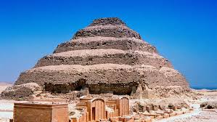
It took some practice…
The Step Pyramid of Pharaoh Djoser (3rd Dynasty), 2650 BC

Slide 8
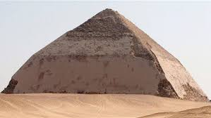
They didn’t always get it right….
The Bent Pyramid of Pharaoh Sneferu (4th dynasty), 2600 BC

Slide 9
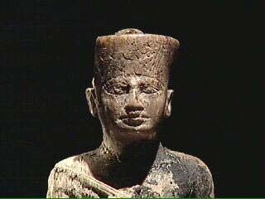
Pharaoh Khufu
Ruled in 2500s BC
Know very little about his life
Best known for monuments built for him

Slide 10
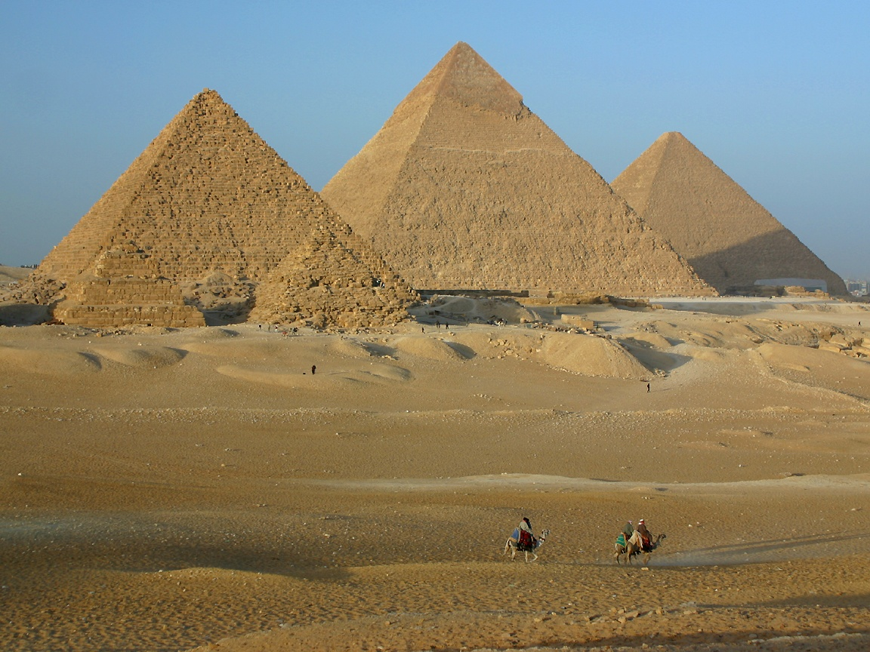
Pyramids of Giza-One of the 7 Wonders of the Ancient World

Slide 11
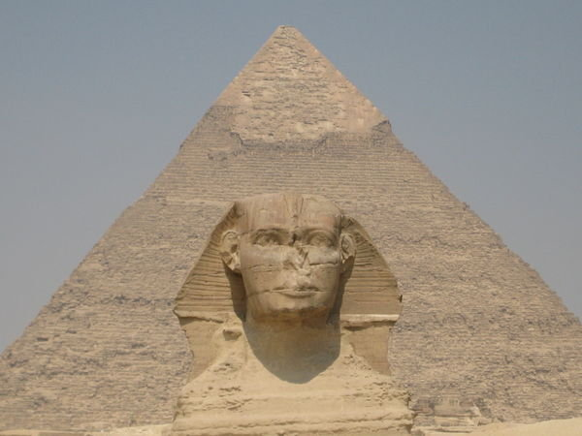
Pyramids of Giza
SPHINX

Slide 12
Menkaure –Grandson, 200 feet tall
Khufu – Grandpa (the Great Pyramid), 455 feet tall
Khafre- Son, 448 feet tall

