Slide 1
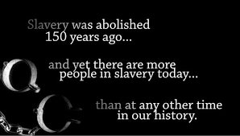
Modern Slavery and Human Trafficking

Slide 2
Facts…
About 46 million people are enslaved
today worldwide
Modern slavery: possession or control of a person that has been deprived of their rights; with the intention of exploiting that person
10 countries in the world hold 70% of all modern day slaves

Slide 3
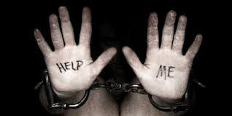
Facts:
Countries with the highest number of slaves include:
1. India 7. Nigeria
2. China 8. Democratic Rep. of
3. Pakistan the Congo
4. Bangladesh 9. Indonesia
5. Uzbekistan 10. Thailand
6. Russia

Slide 4
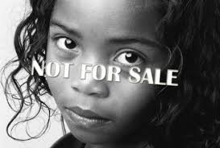
Facts:
Human trafficking/slavery is one of the largest international crime industries after drug & gun smuggling
Slavery is more common in countries where…
-discrimination is prevalent
-the government is unstable
-corruption is prevalent

Slide 5
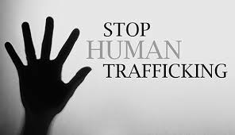
How common is human trafficking in the US?
Between 15,000-18,000 people are trafficked in the US each year
The average cost of a “slave” in the world is $90
26% of people in slavery are children under the age of 18
For more info: www.freetheslaves.net or www.endlsaverynow.org

Slide 6
It’s happening in Indianapolis….
Hope Center – Indianapolis

