Slide 1
Later Peoples of the Fertile Crescent

Slide 2
Assyrians
Iron weapons & chariots
Fierce in battle, burnt crops, looted villages before attacking

Slide 3
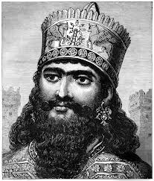
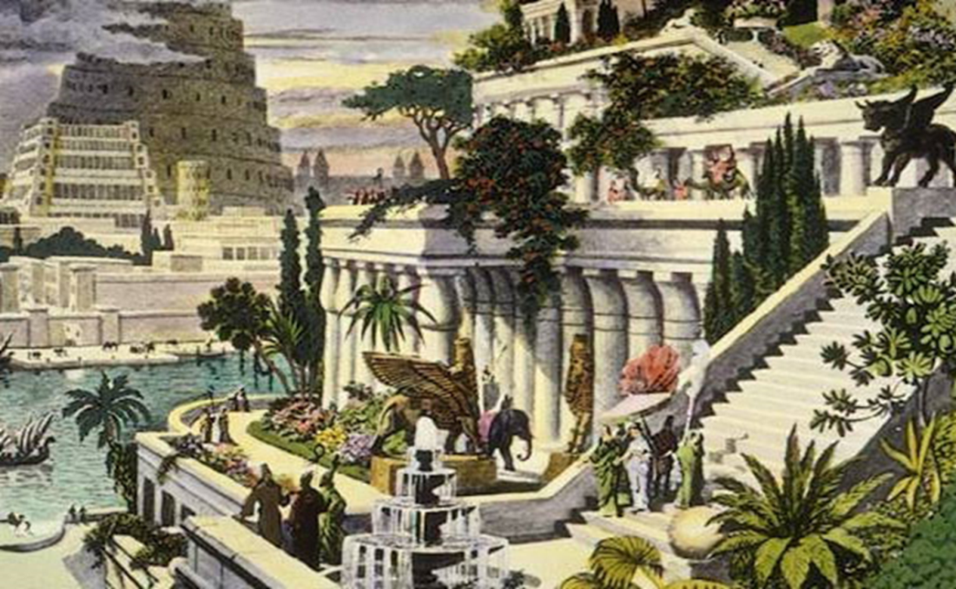
Chaldeans
-Nebuchadnezzar -(the king) rebuilt Babylon and the supposed Hanging Gardens of Babylon (~600BC)
-One of the 7 wonders of the ancient world (myth?)

Slide 4
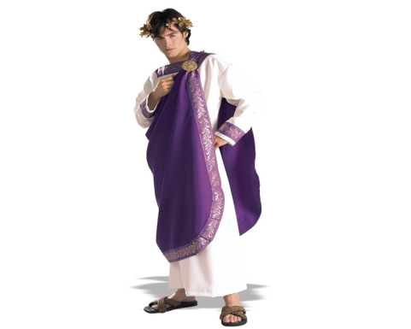
The Phoenicians
Phoenicians-Wealthy trading society on east edge of Mediterranean Sea
Expert sailors & craftspeople
Create purple dye, which becomes very popular with rich people

Slide 5
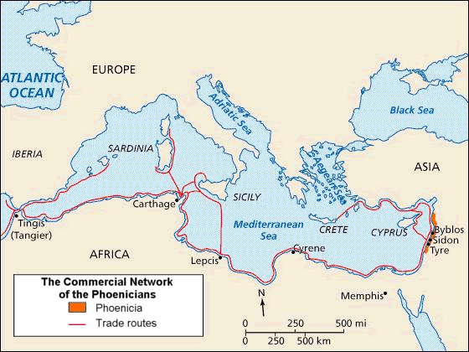

Slide 6
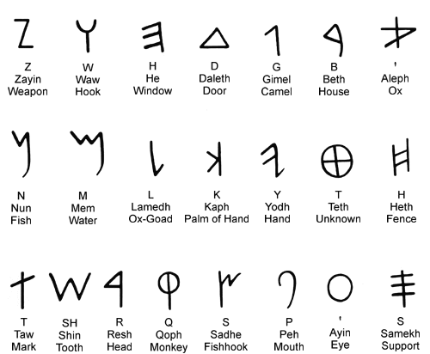
What was the Phoenicians most important achievement?
Invention of an alphabet- a set of letters that can be combined to form words

