Slide 1
The Rise of Sumer – The World’s First Civlizations

Slide 2
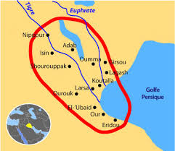
Sumer
Sumerians developed the world’s first civilization
By 3000 B.C., they had
settled in southern
Mesopotamia (Sumer)

Slide 3
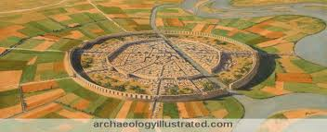
City-States of Sumer
-Centers of Sumerian societies = cities
-Sumer was organized into city-states (Hunger Games?)
City-State- a central city and
all of the countryside around it
-City-states had their own armies and built walls around their cities

Slide 4
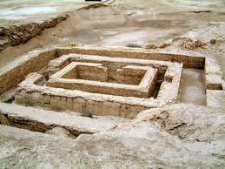
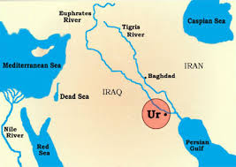
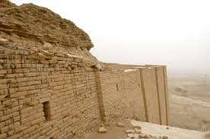
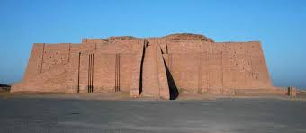
Powerful City-States
-city-states gained and lost power over time
-more farmland=more power
-The most powerful = Uruk & Ur

Slide 5
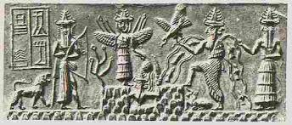
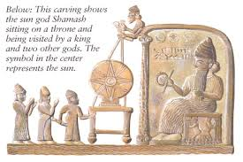
Sumerian Religion
-Sumerians practiced polytheism
Polytheism- worship of many gods
-Each city-state considered one god to be its special protector
(They believed that these gods were very powerful & could bring huge harvests or
disastrous floods)

Slide 6
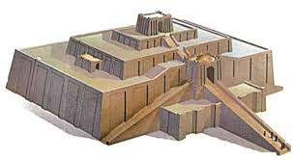
Priests
Priests- people who performed or led religious ceremonies
Very important people in Sumerian society
Priests interpreted wishes of the gods and made offerings to them in temples - ziggurats

Slide 7
Sumerian Social Hierarchy
Social Hierarchy- the division of society by rank or class
Priests
Artisans/Merchants
Farmers/Laborers
Slaves (3 years)
King

Slide 8
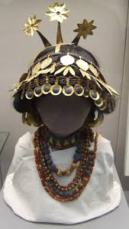
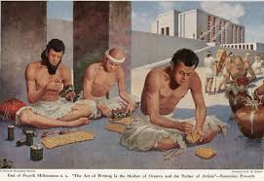
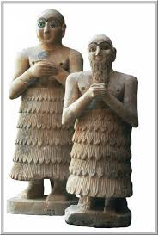
Sumerian Men and Women
Men - held political powers & made laws
Women - took care of home & children
Mostly only men were educated, but some upper-class women were educated as well
Some educated women were priestesses in the temples of Sumer

