Slide 1
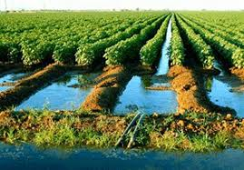
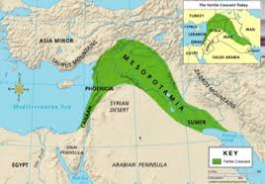
The Fertile Crescent

Slide 2
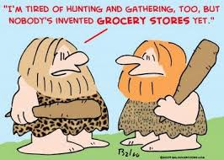
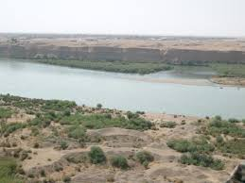
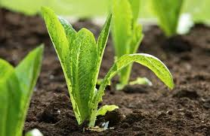
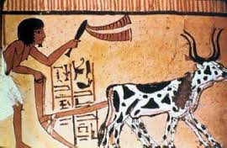
The Rise of Civilizations
How do people move from hunting and gathering to creating complex civilizations? FARMING
Where do civilizations arise? Why?
RIVERS=GOOD SOIL= GOOD FARMING

Slide 3
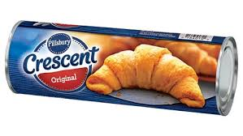
Mesopotamia
-Mesopotamia lies between the Tigris & Euphrates Rivers, in the Fertile Crescent
Fertile Crescent - a large arc of
rich, fertile, farmland in southwest Asia
-Mesopotamia = Greek for “between the rivers”

Slide 4
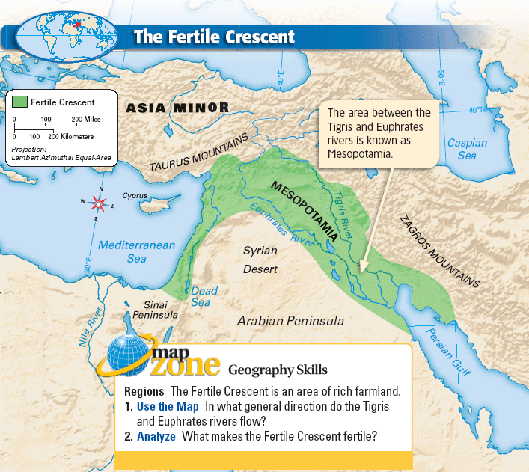
Fertile Crescent

Slide 5
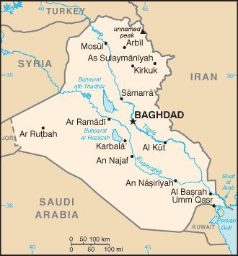
Tigris and Euphrates Rivers - IRAQ
These two rivers lie mostly in the modern-day country of Iraq

Slide 6
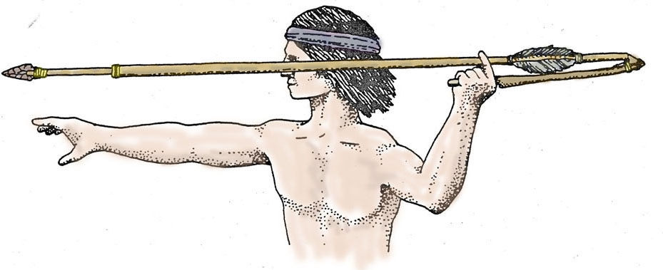
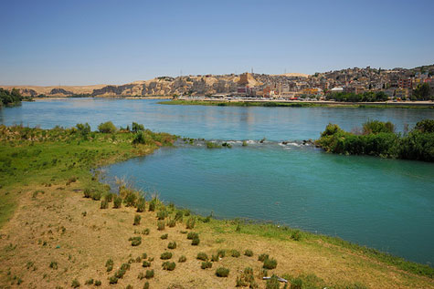
The Rise of Civilization
-First people to settle Mesopotamia were hunter-gatherers (~10,000 BC)
What caused this area to be so fertile?
Silt- a mixture of rich soil and tiny rocks
(and fish poop and other organic material)

Slide 7
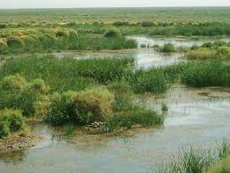
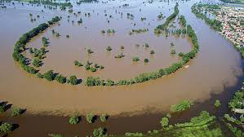
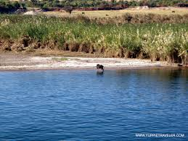
Farming & Cities
-Because of the fertile soil, farming settlements began in Mesopotamia around 7,000 B.C.
-Problem: rivers often flooded

Slide 8
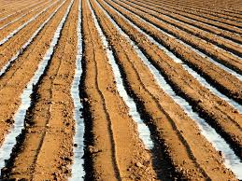
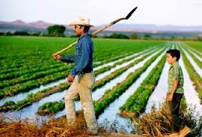
Controlling Water
To combat flooding the early people of Mesopotamia used irrigation & canals
Irrigation- a way of supplying
water to an area of land
Canals- human-made waterways

Slide 9
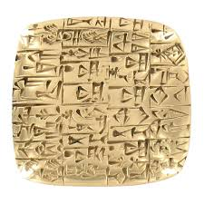
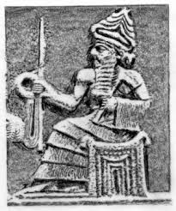
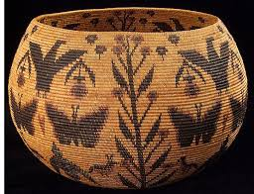
More Food = Special Jobs
Irrigation = increased production of food
= food surplus = special jobs
Surplus- having more than you need
Division of Labor – workers specialize in a particular task or job

Slide 10
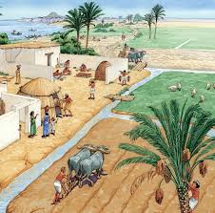
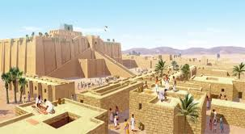
Appearance of Cities
-More food = more people = cities developed
-Most people still farmed
-Cities become centers of trade, politics, religion, & culture

