Slide 1
Longitude and Latitude
8/9/2022

Slide 2
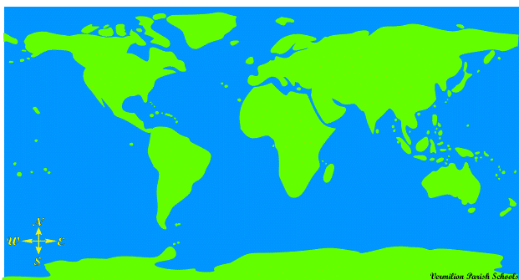
How do we find a specific location on a map of the world?
Notes:
Go over the compass rose

Slide 3
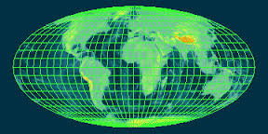
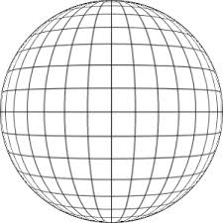
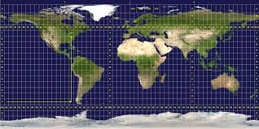
We find exact location by placing a grid over the globe. This system was invented in 3rd-2nd century BC!

Slide 4
2 Most Important Lines: The Equator & Prime Meridian
Notes:
Ask students for their knowledge of the equator and prime meridian.

Slide 5
Prime Meridian- line of longitude that runs north and south - 0 degrees

Slide 6
Prime Meridian separates the Eastern and Western Hemispheres
The Western Hemisphere is west of the Prime Meridian.
The Eastern Hemisphere is east of the Prime Meridian.
Notes:
Refer to the compass rose

Slide 7
Equator – line of latitude that runs east and west – 0 degrees

Slide 8
Equator separates the northern and southern hemispheres
The Northern Hemisphere is north of the Equator.
The Southern Hemisphere is south of the Equator.
Notes:
Refer to compass rose

Slide 9
Longitude- measures how far east or west a location is from the Prime Meridian

Slide 10
Florida is located at 80 degrees west of the Prime Meridian.

Slide 11
Japan is located at 140 degrees east of the Prime Meridian.

Slide 12
What ocean is located at 40 degrees west?
Atlantic Ocean
Notes:
Click to show answers

Slide 13
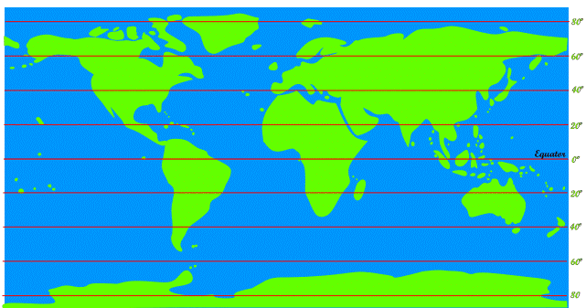
Latitude - measures how far north or south a location is from the Equator
Notes:
Explain how latitude is like climbing a ladder. Phonemic Device

Slide 14
Mexico is located at 20 degrees north of the Equator.

Slide 15
Antarctica is located at 80 degrees south of the Equator.

Slide 16
What state in the United States is located near 60 degrees north?
Alaska
Notes:
Click to show answers

Slide 17
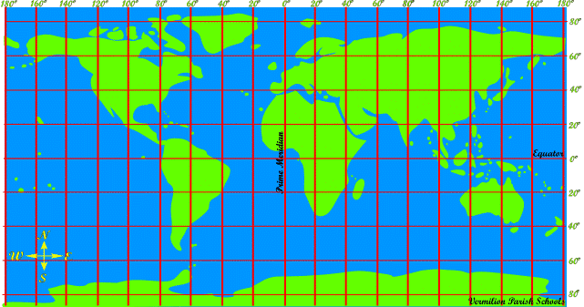
How can I find a location using longitude and latitude?

Slide 18
Coordinates!
Latitude is listed first; Longitude is listed second
Latitude will always be ____ ° North or South
Longitude will always be_____° East or West
Longitude
60 ° North, 160 ° West
Latitude

Slide 19
Start with directions: 60° N, 160° W Latitude, Longitude
Notes:
Click to show the 60 degree circled click again to show the 160 degree circle. One more click will allow the arrow to move to the correct location.

Slide 20
Which continent is located at 20° S, 20° E
Africa
Notes:
Click to show the 20 degree circled click again to show the other 20 degree circle. One more click will allow the name of the continent to appear.

Slide 21
Which ocean is located at 0°, 80° E
Indian Ocean
Notes:
Click to show the 0 degree circled click again to show the other 80 degree circle. One more click will allow the name of the ocean to appear.

Slide 22
Which ocean is located at 40° S, 140° W
Pacific Ocean
Notes:
Click to show the 40 degree circled click again to show the other 140 degree circle. One more click will allow the name of the ocean to appear.

Slide 23
Which continent is located at 50° N, 100° W
North America
Notes:
Click to show the 50 degree circled click again to show the other 100 degree circle. One more click will allow the name of the continent to appear.

Slide 24
World Map
Notes:
Ask students about random locations or have students come up with locations to find on the map.

