Slide 1
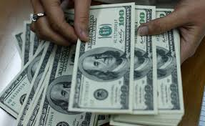
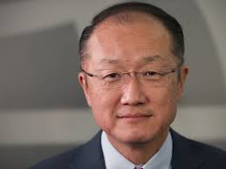
THE WORLD BANK
Helps poor countries get money to reduce poverty and build improvements
Give grants and loans
(interest free)
Goal is to improve living conditions for people in poor nations

Slide 2
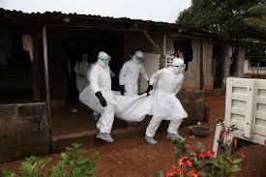
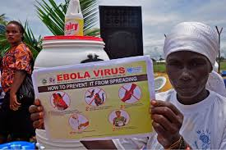
THE WORLD HEALTH ORGANIZATION
WHO
Organization within the UN
Improves health around the world
Responds to health crises around the world
Example: Ebola Outbreak, Zika Virus

Slide 3
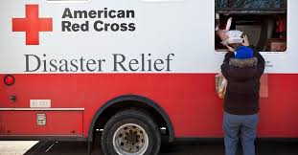
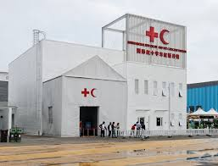
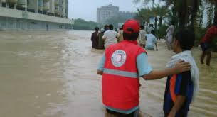
THE RED CRESCENT & RED CROSS
Disaster response around the world
Each country has its own society
Education
Identify remains
Help survivors
Medical Care
Shelter
Prisoners of War

Slide 4
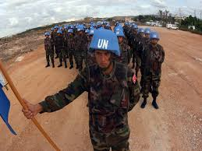
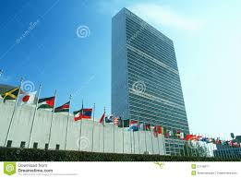
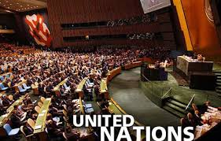
THE UNITED NATIONS
UN
Created after WWII
193 member nations
Keeping peace in trouble areas
Developing friendly relations among nations
Improving quality of life for poor – UNICEF, WFP
Headquarters in NYC

Slide 5
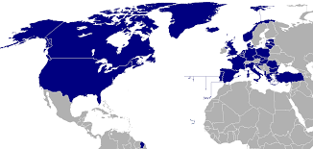
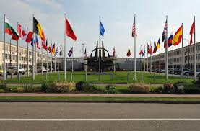
THE NORTH ATLANTIC TREATY ORGANZATION
NATO
Protection (defense) Pact
US & European countries
28 members
Keep peace and security by working together
Use resources to help each other in case of natural disasters

Slide 6
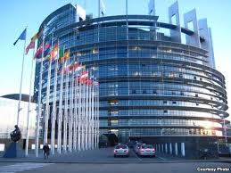
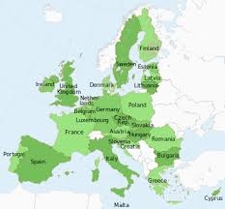
THE EUROPEAN UNION
EU
Help avoid conflict in Europe by making European countries dependent on one another
Create a single economy
Same unit of money = Euro
Goods traded without being taxed
More power by acting as a group
United Kingdom recently left

Slide 7
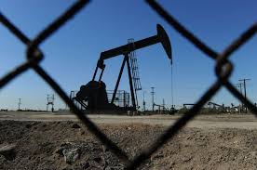
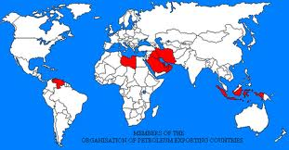
Organization of the Petroleum Exporting Countries
OPEC
Created in 1960
12 countries, world’s major oil exporters
Purpose = manage the world’s oil supply & the price of oil
12 countries hold about 80% of oil supply
Saudi Arabia, Iran, Iraq, United Arab Emirates, Nigeria, Venezuela

