Slide 1
Indus Valley Civilization
Part 2

Slide 2
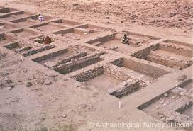
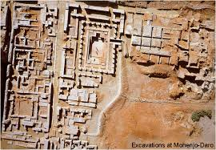
City Planning
Harappa & Mohenjo-Daro were well planned
Brick streets
Towers for defense
Streets in grid patterns
Sewer system
Indoor plumbing
Flat, cool roofs on homes

Slide 3
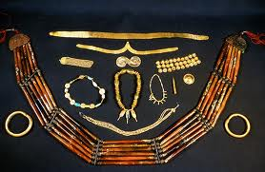
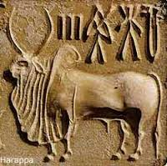
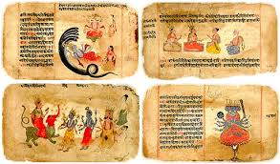
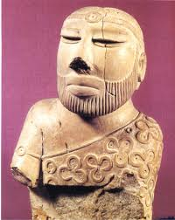
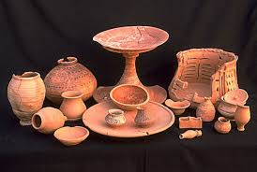
Indus Achievements
Art – pottery, jewelry, seals
Wheeled vehicles
Evidence of social classes
Little known about religion & government
Vedas – ancient religious poems/hymns

Slide 4
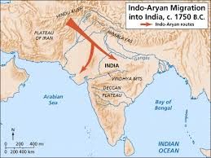
The End…
Harappan civilization disappears around 1,700 BC -We don’t know why…
Best guess = natural disaster
New nomadic group from central Asia arrives, settle &
become farmers =
Aryans

Slide 5
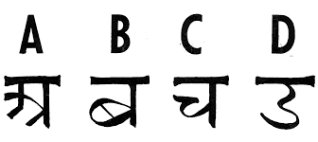
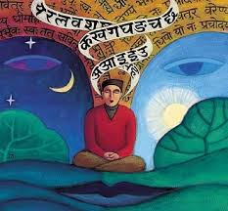
Early Aryans
Bring the caste system, religion, language
Speak, then write Sanskrit - language of ancient India
Sanskrit is from same language group as English
Sanskrit – Mother = MATAR
English – Mother = MOTHER

