Slide 1
History & Culture of Southern Africa

Slide 2
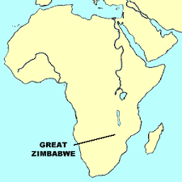
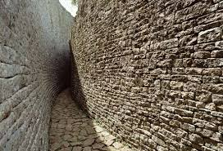
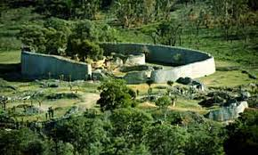
Early South African History
Shona Empire– 1000 - 1400s AD
Located in Zimbabwe & Mozambique
Capital – Great Zimbabwe (“Stone Walled Town”)
Farmers & gold traders

Slide 3
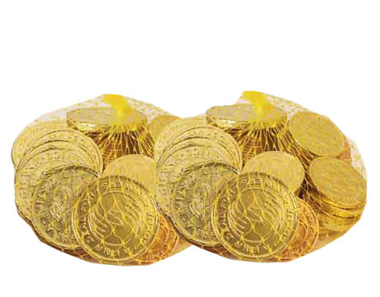
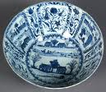
Early People: The Shona
-Great Zimbabwe traded gold & became rich & powerful
-Archaeologists found Chinese porcelain from Asia in Great Zimbabwe
-Shona were part of a large trade network

Slide 4
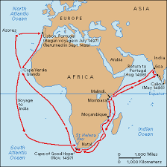
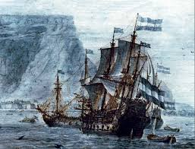
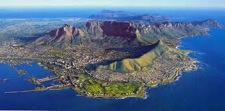
Guess Who Shows Up??? The Europeans!
Looking for a route to Asia…
Dutch –create a permanent settlement in 1652 AD
Settle at the Cape of Good Hope
Station for ships to resupply on way to Asia

Slide 5
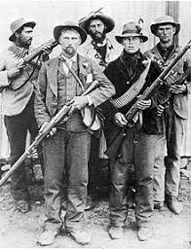
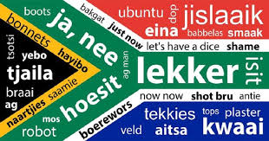
The People of the “Cape Colony”
Many Europeans settle in Cape(Dutch, Germans, French)
Afrikaners - Descendants of Europeans who settle there
Afrikaans = new language spoken by Afrikaners = Mix of Dutch & African languages
1800s – British take
control of the colony

Slide 6
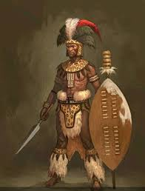
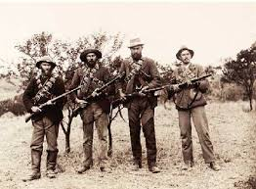
The Boer War (1899-1902)
Boer War – Fighting between British, Zulu (Africans), & Afrikaners for land
1902 – British win
1931 – South Africa becomes independent
from Great Britain

Slide 7
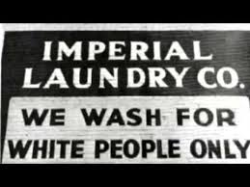
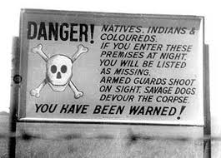
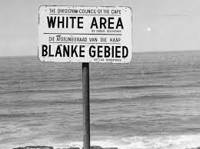
The Beginning of Apartheid…
Independent government becomes dominated by racist, white Afrikaners
Apartheid – “Apartness”
Apartheid= a policy of separation of the races -1948
4 groups:
Whites
Blacks
Coloreds (mixed race)
Asians

Slide 8
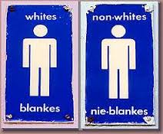
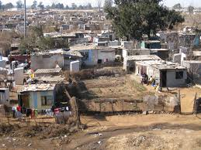
Life Under Apartheid
Townships – separate areas where black South Africans were forced to live
Blacks Whites
Poor Schools Good Schools
Bad Land Best Land
No right to vote Right to Vote
Cannot marry whites Best Neighborhoods
Must carry passes Best healthcare/schools

Slide 9
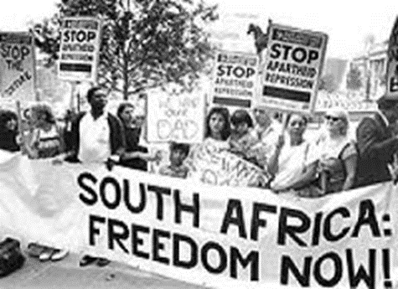
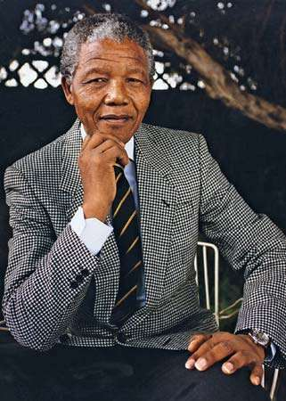
Nelson Mandela (1918-2013) – leader of the anti-apartheid movement in South Africa
African National Congress – group of black South Africans who used civil disobedience (and sometimes violence!) to protest against Apartheid
Imprisoned on Robben Island for 27 years
Winner of Nobel Peace Prize in 1993

Slide 10
South Africa – How Does the World React to Apartheid?
1. Governments around the world put sanctions on S. Africa
Sanctions- economic or political penalties imposed on a country by another country to force a change in policy
(Countries banned trade w/ South Africa)
2. Sports organizations refused to include South Africa in competitions

Slide 11
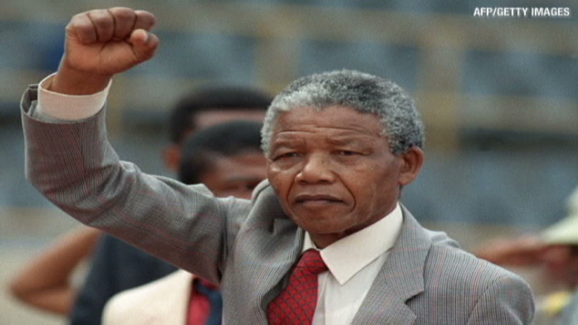
Ending Apartheid
1990- South Africa released their political prisoners including Nelson Mandela
1994 - Mandela was elected president - all races gained the right to vote
1991-1994 – Apartheid ends
Today all races have equal rights

Slide 12
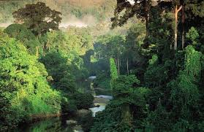
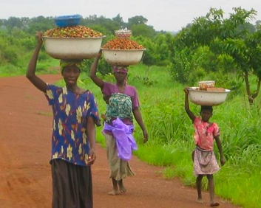
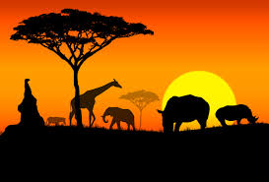
Major Issues & Challenges
Poverty
Disease – HIV/AIDS
Environmental Destruction
Racial Equality

