Slide 1
Egyptian Society & Achievements

Slide 2
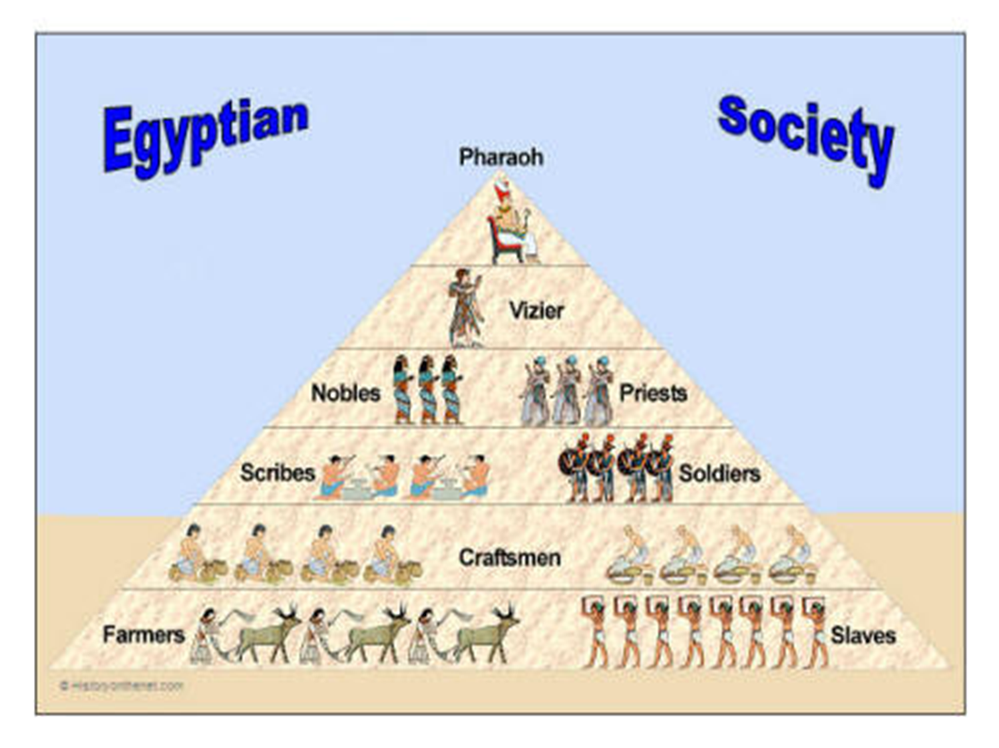
Vizier = Advisor to the pharaoh
80% of Egyptian people

Slide 3
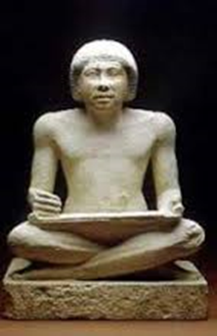
People in Egyptian Society…
Scribes – professional writers
Important members of middle class
Work for govt. or in temples
Exempt from paying taxes!

Slide 4
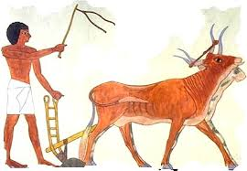
People in Egyptian Society…
Farmers and Peasants
- Majority of Egyptian population
- All land owned by pharaoh, after harvest some given to pharaoh as payment
- Could be forced to do mining, fighting, building projects

Slide 5
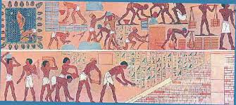
People in Egyptian Society…
Slaves
- Bottom of social pyramid
- Many were criminals or prisoners
- In some cases, could earn their freedom

Slide 6
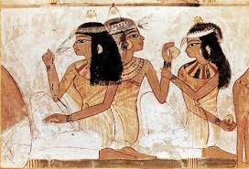
People in Egyptian Society…
Family
Important - Men expected to marry young
Most children receive some education
Boys enter father’s profession @ 14 years of age
Women have some rights:
Own property
Make contracts
Can divorce husband

Slide 7
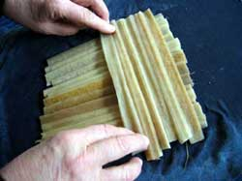
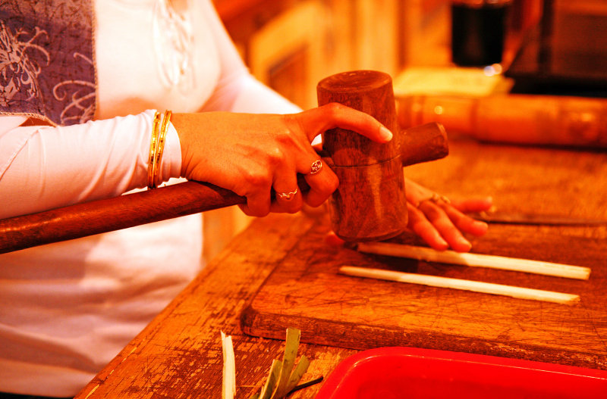
Egyptian Writing
Hieroglyphs- Egyptian writing system
Papyrus- a long lasting paper-like material made from reeds

Slide 8
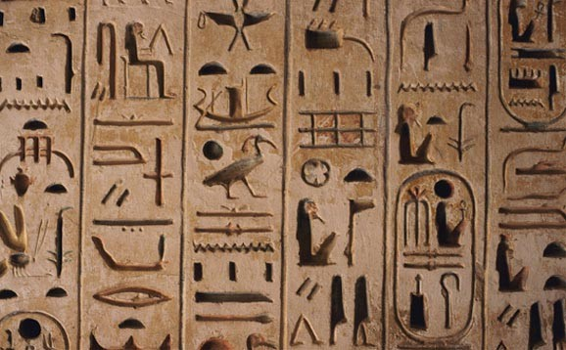
Egyptian Writing
More than 600 symbols used in hieroglyphic writing
Written from right to left or left to right,
vertically or horizontally

Slide 9
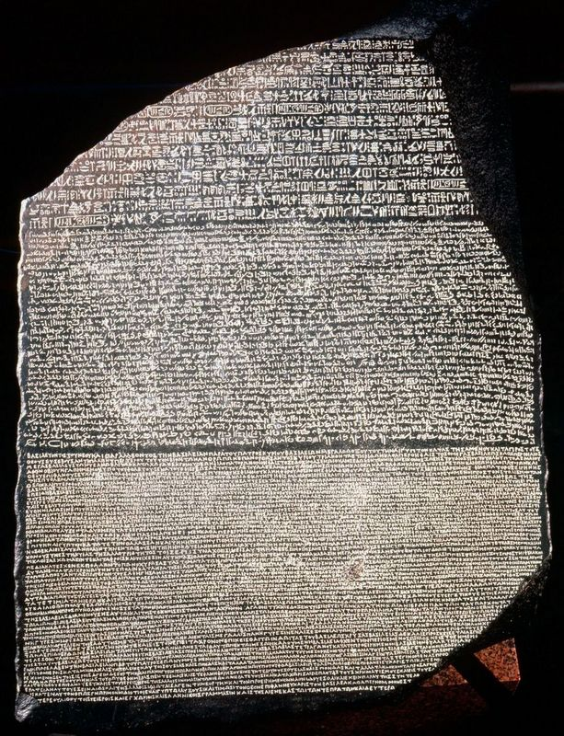
Rosetta Stone
Found by a French soldier in 1799
Rosetta Stone- a huge, stone slab inscribed with hieroglyphs, Greek,
later form of Egyptian
Allowed us to translate hieroglyphics

Slide 10
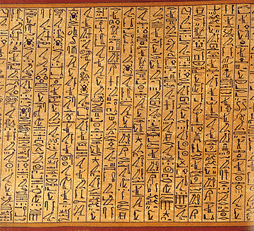
Egyptian Texts
Egypt’s dry climate helped preserve some papyrus writings
(Medical text)

Slide 11
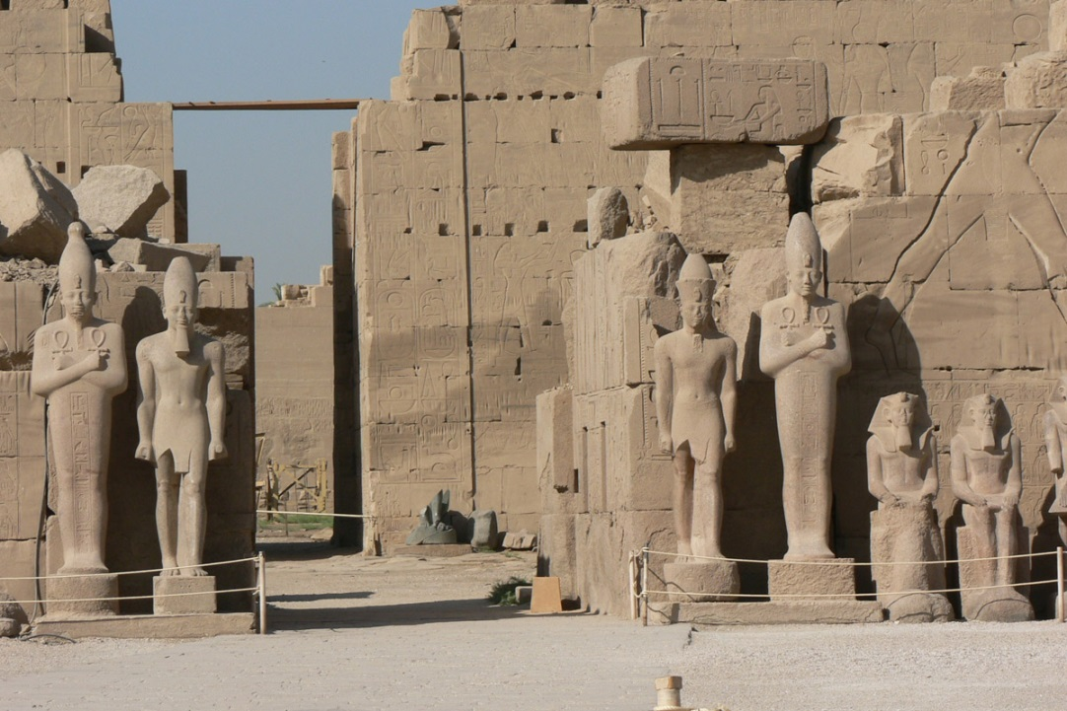
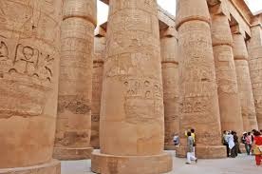
Architecture - Great Temples
Ancient Egyptians built great temples
Seen as homes of the gods, heavily decorated
Temple of Karnak (Largest)

Slide 12
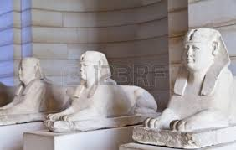
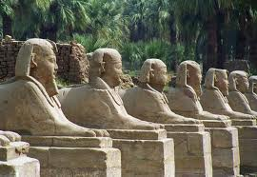
Architecture - Sphinxes
Sphinxes- imaginary creatures with the bodies of lions and heads of other animals or humans

Slide 13
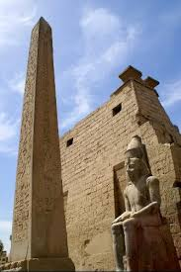
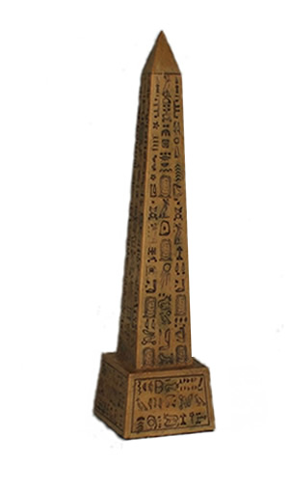
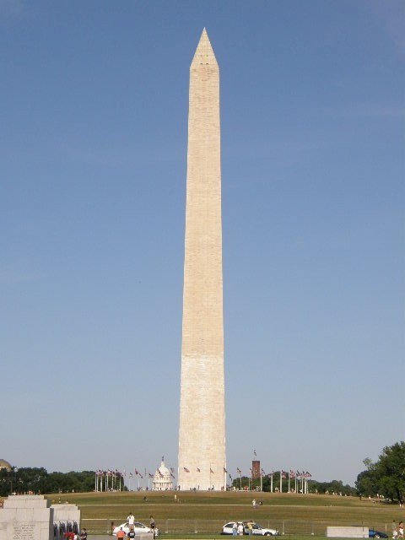
Architecture -Obelisks
Obelisk- a tall, four-sided pillar that is pointed on top

