Slide 2
Geography of Early Egypt

Slide 3
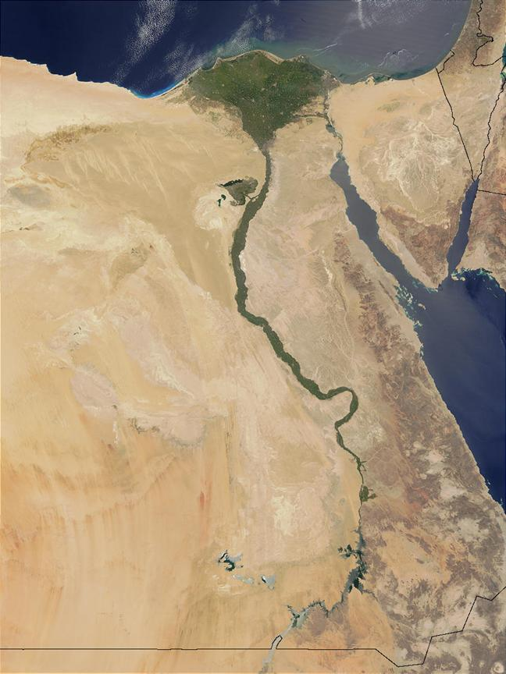
What enabled life to thrive in Egypt?
Egypt =
“The Gift of the Nile”
THE NILE RIVER

Slide 5
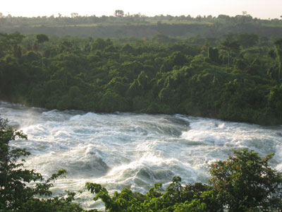
Nile River
Longest river in the world (over 4,000 miles)
Flows through rocky, hilly land
cataracts- rapids (6 total)
Cataracts made it impossible to sail the whole river

Slide 6
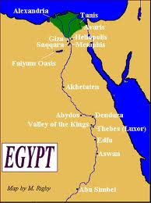
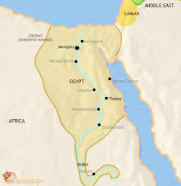
Natural Barriers= Protection
North- Mediterranean Sea
West- Large desert
East- Desert & Red Sea
South- Cataracts

Slide 7
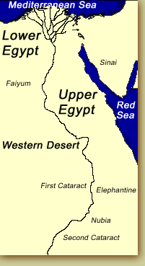
2 Regions of Ancient Egypt
Lower Egypt = North
Upper Egypt = South
Nile runs south
to north
Elevation is higher
in the south

Slide 8
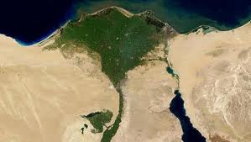
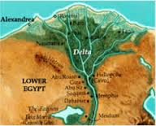
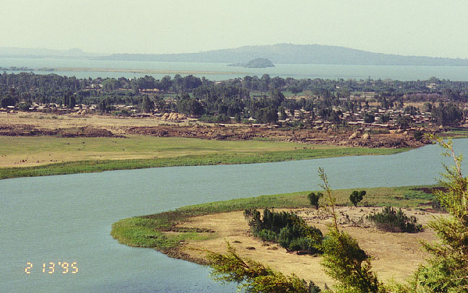
Nile River
In Lower Egypt, Nile fans out and flows into the Mediterranean Sea
Delta- triangle-shaped area of land made from soil deposited by a river

Slide 9
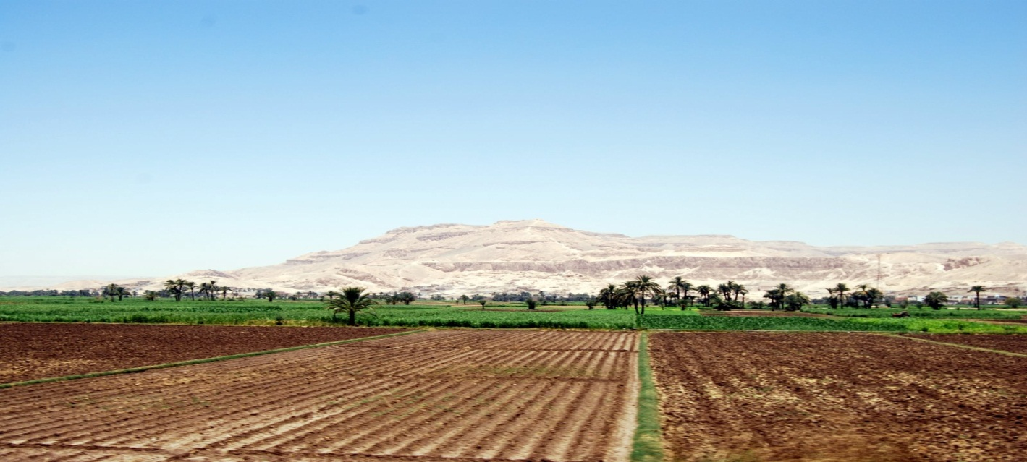
Egyptian Farming
Nile flooded yearly
(upper in summer,
lower in fall)
Floods deposited silt
Silt = good for farming
(Sound familiar????)

