Slide 1
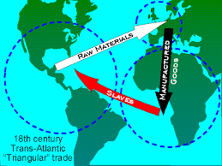
Bell-Ringer: monday, April 29
Matching!
1. Traded for slaves A. Middle Passage
during the West B. guns & alcohol
African slave trade C. hajj
D. diamonds
2. Crop grown in the E. tomatoes
Americas F. Ghana
3. W. Africa’s MVE today G. oil
4. Mansa Musa’s trip to H. Nigeria
Mecca I. cotton
5. Trip across the Atlantic
Ocean for slaves

